Slide 1
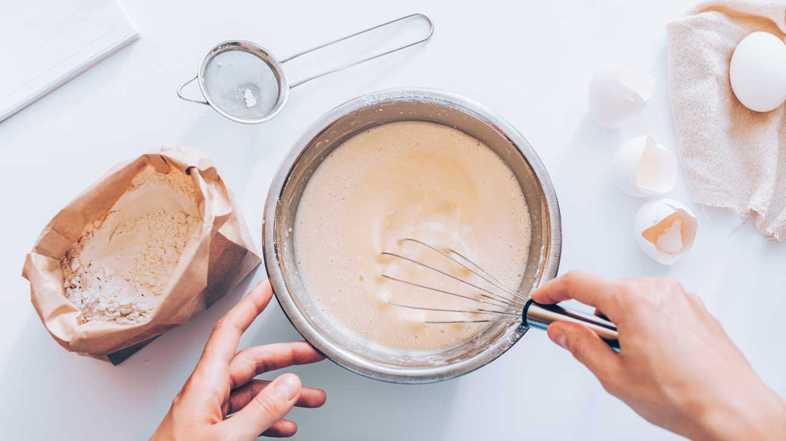
BAKERS LOUNGE
By
Aneeta L R (Reg No.:- 180021096023)
Under The Guidance Of
Mrs. Minnu Martha Shibu

Slide 2
INTRODUCTION

Slide 3
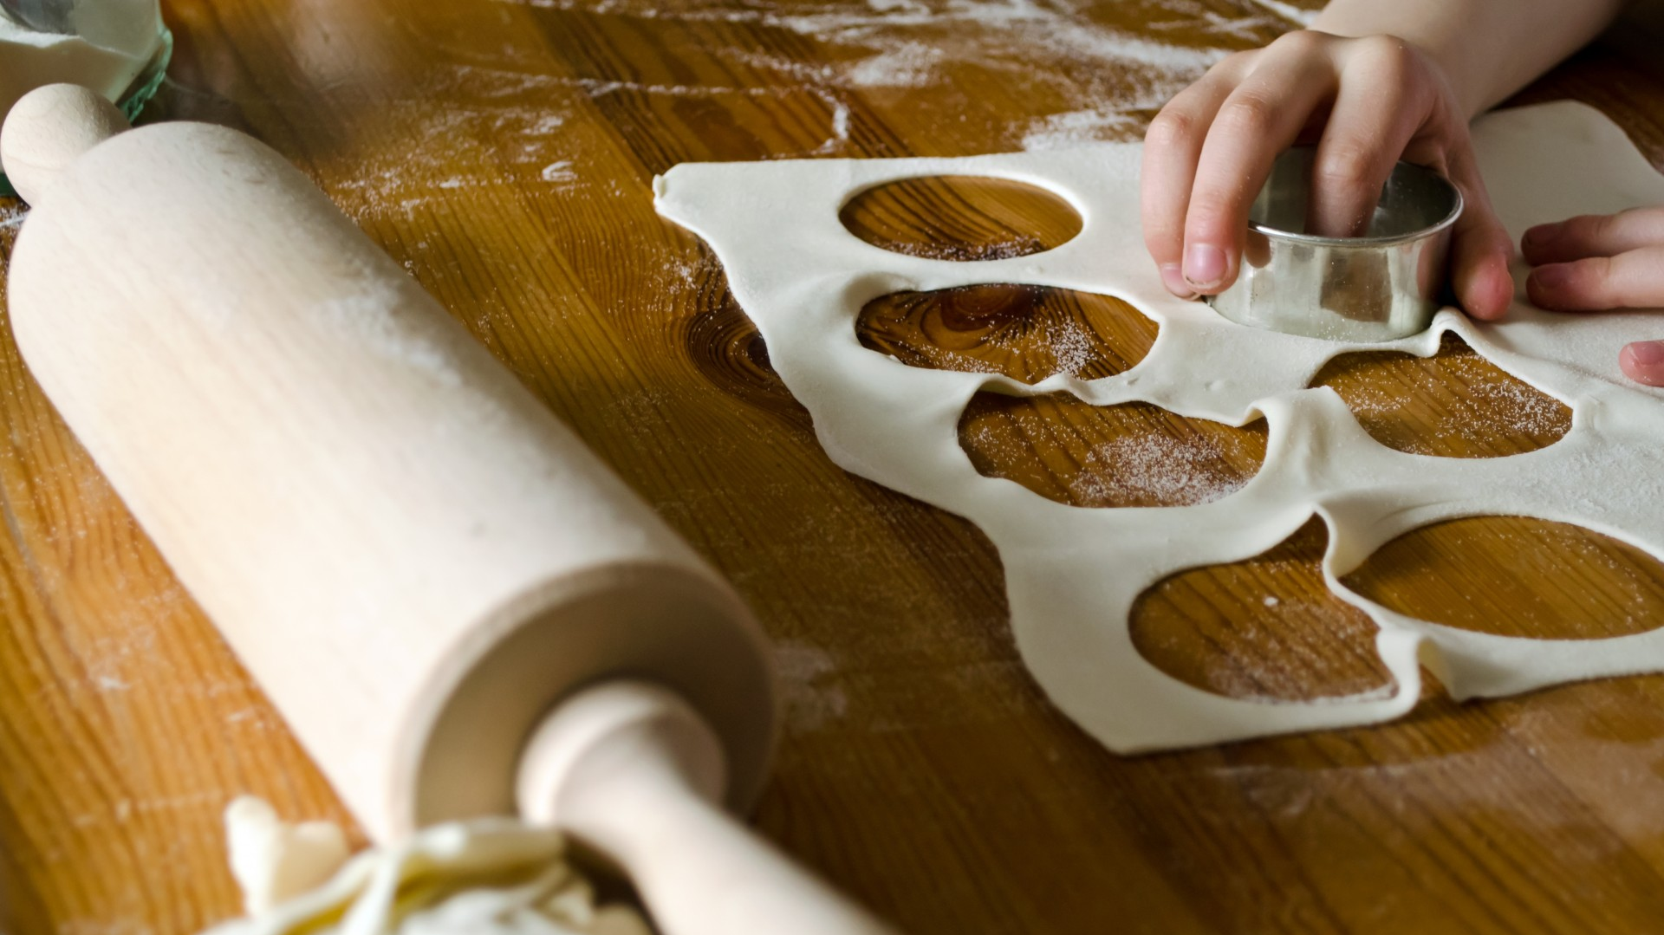
Bakers lounge is a website mainly for encouraging people who are good at baking
Shops selling baking products and tools can upload them here
Help bakers to buy ingredients and tools without leaving the house
Help bakers and shops to start and improve their business
Help customers to find bakers and book products and cakes in advance
Customers can book customized cakes
Provide delivery facility
People who are willing to work as delivery boy can register here

Slide 4
EXISTING SYSTEM

Slide 5
There are many websites that help people to buy bakery items
These websites help shops(bakery) to grow their income
These websites focus on shops rather than bakers
These websites also provide delivery facility

Slide 6
ADVANTAGES OF EXISTING SYSTEM
Can find almost all things at one place(one shop)
Helps grow shop’s business
Customers can easily find shops near by them
Provide jobs to people who are willing to work as delivery boy
DISADVANTAGES OF EXISTING SYSTEM
Doesn’t help individual bakers to start or grow their business
Some shops don’t make customized cakes

Slide 7
PROPOSED SYSTEM

Slide 8
Help people who are baking at home earn money
Focus is on individual bakers rather than bakeries(shops)
Bakers can easily find and buy any type of ingredients and tools for baking easily through this website
Bakers can find shops near by them to buy things for baking
Customers can book customized cakes
They can find bakers near by them or by location
Items booked by both bakers and customers will reach the delivery address through delivery team

Slide 9
ADVANTAGES OF PROPOSED SYSTEM
Help both individual bakers and shops selling products used in baking to earn more money
By providing tools and ingredients baking becomes easier for home bakers
Help customer order customized products
Find shops and bakers according to location and book products
Provide jobs to people who are willing to work as delivery boy
Delivery team will help bakers and shops to make their order’s delivery easy

Slide 10
DISADVANTAGES OF EXISTING SYSTEM
Sometimes customers can’t find all their needed product from one baker
Bakeries can’t register
Once delivery is assigned to deliveryboy, they are forced to do that delivery
Unsuccessful booking of customized cake
Have to enter address each for ordering

Slide 11
MODULE DESCRIPTION

Slide 12
BAKERS LOUNGE
ADMIN
GUEST
BAKER
SHOP
DELIVERY BOY
CUSTOMER

Slide 13
ADMIN
Login
Dashboard
Add district
Add place
Add cake type
Add product type
Add complaint type
Add flavour
Verify shop registration
View bakers
Verify delivery boys
View customers
View Complaints and response
Bakers
Shops
Customers

Slide 14
GUEST
Shop registration with payment
Customer’s registration
Baker’s registration
Delivery boy's registration
Login
About us
Contact us
Gallery

Slide 15
BAKER
Login
Homepage
Privacy
My profile
Edit profile
Change password
Manage products
Add
Delete
Gallery
Manage cake
Add
Delete
Gallery
View and accept customized cake orders
Assign delivery boys
Search shops
According to location
Add and manage ingredients and tools to cart
Order ingredients and tools
Order details
Order status
Payment gateway
Tools
Ingredients
View delivery status
Product, cakes and customized cake
Ingredients and tools

Slide 16
SHOP
Login
Homepage
Privacy
My profile
Edit profile
Change password
Manage ingredient
Add
Delete
Images
Managing stock
Manage tools
Add
Delete
Image
Managing stock
View and manage order
Bakers details
Ingredient or tool details
Order details
Assign delivery boy
View delivery status

Slide 17
CUSTOMER
Login
Homepage
Privacy
My profile
Edit profile
Change password
Search bakers
According to location
Search products
According to location
According to product type
Search cake
According to location
According to cake type
Add products and cakes to cart
Order products
Order cake
Order customized cake
Payment gateway
Cake
Product
Customized cake
View Order status
View delivery status
Add complaint

Slide 18
DELIVERY BOY
Login
Homepage
Privacy
My profile
Edit profile
Change password
View assigned works
From shop
From baker
Update delivery status

Slide 19
TABLE DESIGN

Slide 20
tbl_district
tbl_caketype
SL NO. | FIELD | TYPE | SIZE | COMMENT
1. | district_id | int | 4 | Primary key
2. | district_name | nvarchar | 50
SL NO. | FIELD | TYPE | SIZE | COMMENT
1. | caketype_id | int | 4 | Primary key
2. | caketype_name | nvarchar | 50
tbl_place
SL NO. | FIELD | TYPE | SIZE | COMMENT
1. | place_id | int | 4 | Primary key
2. | place_name | nvarchar | 50
3. | district_id | int | 4 | Foreign key
tbl_producttype
SL NO. | FIELD | TYPE | SIZE | COMMENT
1. | producttype_id | int | 4 | Primary key
2. | producttype_name | nvarchar | 50
tbl_flavour
SL NO. | FIELD | TYPE | SIZE | COMMENT
1. | flavour_id | int | 4 | Primary key
2. | flavour_name | nvarchar | 50
tbl_admin
SL NO. | FIELD | TYPE | SIZE | COMMENT
1. | admin_id | int | 4 | Primary key
2. | admin_name | nvarchar | 50
3. | admin_password | nvarchar | 50
tbl_complainttype
SL NO. | FIELD | TYPE | SIZE | COMMENT
1. | complainttype_id | int | 4 | Primary key
2. | complainttype_name | nvarchar | 50

Slide 21
tbl_baker
tbl_baker
SL NO. | FIELD | TYPE | SIZE | COMMENT
1. | baker_id | int | 4 | Primary key
2. | baker_name | nvarchar | 50
3. | baker_gender | nvarchar | 50
4. | baker_address | nvarchar | 50
5. | baker_proof | nvarchar | 50
6. | baker_photo | nvarchar | 50
7. | baker_contact | nvarchar | 50
8. | baker_email | nvarchar | 50
9. | baker_username | nvarchar | 50
10. | baker_password | nvarchar | 50
11. | baker_status | nvarchar | 50
12. | place_id | int | 4 | Foreign key
SL NO. | FIELD | TYPE | SIZE | COMMENT
1. | shop_id | int | 4 | Primary key
2. | shop_name | nvarchar | 50
3. | shop _logo | nvarchar | 50
4. | shop _address | nvarchar | 50
5. | shop _proof | nvarchar | 50
6. | shop_licno | nvarchar | 50
7. | shop _contact | nvarchar | 50
8. | shop _email | nvarchar | 50
9. | shop_ownername | nvarchar | 50
10. | shop_ownercontact | nvarchar | 50
11. | shop_owneraddr | nvarchar | 50
12. | shop_ownerproof | nvarchar | 50
13. | shop _username | nvarchar | 50
14. | shop _password | nvarchar | 50
15. | shop _status | nvarchar | 50
16. | Shop_pstatus | nvarchar | 50
17. | place_id | int | 4 | Foreign key
tbl_customer
SL NO. | FIELD | TYPE | SIZE | COMMENT
1. | user_id | int | 4 | Primary key
2. | user_name | nvarchar | 50
3. | user_address | nvarchar | 50
4. | user_contact | nvarchar | 50
5. | user_email | nvarchar | 50
6. | user_username | nvarchar | 50
7. | user_password | nvarchar | 50
8. | place_id | int | 4 | Foreign key

Slide 22
tbl_deliveryboy
tbl_cakegallery
SL NO. | FIELD | TYPE | SIZE | COMMENT
1. | deliveryboy_id | int | 4 | Primary key
2. | deliveryboy_name | nvarchar | 50
3. | deliveryboy_gender | nvarchar | 50
4. | deliveryboy_address | nvarchar | 50
5. | deliveryboy_proof1 | nvarchar | 50
6. | deliveryboy_proof2 | nvarchar | 50
7. | deliveryboy_photo | nvarchar | 50
8. | deliveryboy_contact | nvarchar | 50
9. | deliveryboy_email | nvarchar | 50
10. | deliveryboy_username | nvarchar | 50
11. | deliveryboy_password | nvarchar | 50
12. | deliveryboy _status | nvarchar | 50
13. | place_id | int | 4 | Foreign key
SL NO. | FIELD | TYPE | SIZE | COMMENT
1. | cakegallery_id | int | 4 | Primary key
2. | cakegallery_image | nvarchar | 50
3. | cake_id | int | 4 | Foreign key
tbl_product
SL NO. | FIELD | TYPE | SIZE | COMMENT
1. | product_id | int | 4 | Primary key
2. | product_name | nvarchar | 50
3. | product_description | nvarchar | 50
4. | product_price | nvarchar | 50
5. | product_quantity | nvarchar | 50
6. | product _image | nvarchar | 50
7. | producttype_id | int | 4 | Foreign key
8. | baker_id | int | 4 | Foreign key
tbl_cake
SL NO. | FIELD | TYPE | SIZE | COMMENT
1. | cake_id | int | 4 | Primary key
2. | cake _name | nvarchar | 50
3. | cake _description | nvarchar | 50
4. | cake _price | nvarchar | 50
5. | cake _weight | nvarchar | 50
6. | cake _image | nvarchar | 50
7. | caketype_id | int | 4 | Foreign key
8. | baker_id | int | 4 | Foreign key
tbl_gallery
SL NO. | FIELD | TYPE | SIZE | COMMENT
1. | gallery_id | int | 4 | Primary key
2. | gallery_image | nvarchar | 50
3. | cake_id | int | 4 | Foreign key

Slide 23
tbl_ingredient
tbl_tool
SL NO. | FIELD | TYPE | SIZE | COMMENT
1. | ingredient_id | int | 4 | Primary key
2. | ingredient_name | nvarchar | 50
3. | ingredient_description | nvarchar | 50
4. | ingredient_price | nvarchar | 50
5. | Ingredient_expiry | nvarchar | 50
6. | ingredient _image | nvarchar | 50
7. | shop_id | int | 4 | Foreign key
SL NO. | FIELD | TYPE | SIZE | COMMENT
1. | tool_id | int | 4 | Primary key
2. | tool_name | nvarchar | 50
3. | tool_description | nvarchar | 50
4. | tool_price | nvarchar | 50
5. | tool_image | nvarchar | 50
6. | shop_id | int | 4 | Foreign key
tbl_ingredientgallery
tbl_toolgallery
SL NO. | FIELD | TYPE | SIZE | COMMENT
1. | ingallery_id | int | 4 | Primary key
2. | ingallery_image | nvarchar | 50
3. | ingredient_id | int | 4 | Foreign key
SL NO. | FIELD | TYPE | SIZE | COMMENT
1. | toolgallery_id | int | 4 | Primary key
2. | toolgallery_image | nvarchar | 50
3. | tool_id | int | 4 | Foreign key
tbl_ingredientstock
tbl_toolstock
SL NO. | FIELD | TYPE | SIZE | COMMENT
1. | instock_id | int | 4 | Primary key
2. | instock_image | nvarchar | 50
3. | instock_id | int | 4 | Foreign key
SL NO. | FIELD | TYPE | SIZE | COMMENT
1. | toolstock_id | int | 4 | Primary key
2. | toolstock_quantity | nvarchar | 50
3. | tool_id | int | 4 | Foreign key

Slide 24
tbl_cakebook
tbl_productbook
SL NO. | FIELD | TYPE | SIZE | COMMENT
1. | cakebook_id | int | 4 | Primary key
2. | cakebook_quantity | nvarchar | 50
3. | cakebook_totalamount | nvarchar | 50
4. | cakebook_date | nvarchar | 50
5. | cakebook_deliveryaddr | nvarchar | 50
6. | cakebook_deliverydate | nvarchar | 50
7. | cakebook_caption | nvarchar | 50
8. | cakebook_pickupaddr | nvarchar | 50
9. | cakebook_cstatus | nvarchar | 50
10. | cakebook_pstatus | nvarchar | 50
11. | cakebook_dstatus | nvarchar | 50
12. | cake_id | int | 4 | Foreign key
11. | user_id | int | 4 | Foreign key
SL NO. | FIELD | TYPE | SIZE | COMMENT
1. | productbook_id | int | 4 | Primary key
2. | productbook_quantity | nvarchar | 50
3. | productbook_totalamount | nvarchar | 50
4. | productbook_date | nvarchar | 50
5. | productbook_deliveryaddr | nvarchar | 50
6. | productbook_deliverydate | nvarchar | 50
7. | productbook_pickupaddr | nvarchar | 50
8. | productbook_cstatus | nvarchar | 50
9. | productbook_pstatus | nvarchar | 50
10. | productbook_dstatus | nvarchar | 50
11. | product_id | int | 4 | Foreign key
12. | user_id | int | 4 | Foreign key

Slide 25
tbl_assignborder
tbl_customizecake
SL NO. | FIELD | TYPE | SIZE | COMMENT
1. | assignborder_id | int | 4 | Primary key
2. | assignborder_date | nvarchar | 50
3. | assignborder_status | nvarchar | 50
4. | ccake_id | int | 4 | Foreign key
5. | cakebook_id | int | 4 | Foreign key
6. | productbook_id | int | 4 | Foreign key
7. | deliveryboy_id | int | 4 | Foreign key
SL NO. | FIELD | TYPE | SIZE | COMMENT
1. | ccake_id | int | 4 | Primary key
2. | ccake _shape | nvarchar | 50
3. | ccake _caption | nvarchar | 50
4. | ccake _detail | nvarchar | 50
5. | ccake _weight | nvarchar | 50
6. | ccake _date | nvarchar | 50
7. | ccake_deliveryaddr | nvarchar | 50
8. | ccake _deliverydate | nvarchar | 50
9. | ccake _pickupaddr | nvarchar | 50
10. | ccake _status | nvarchar | 50
11. | ccake _pstatus | nvarchar | 50
12. | ccake _dstatus | nvarchar | 50
13. | ccake_totalamount | nvarchar | 50
14. | flavour_id | Int
15. | user_id | int | 4 | Foreign key
16 | baker_id | int | 4 | Foreign key
tbl_toolbook
SL NO. | FIELD | TYPE | SIZE | COMMENT
1. | toolbook_id | int | 4 | Primary key
2. | toolbook_quantity | nvarchar | 50
3. | toolbook_totalamount | nvarchar | 50
4. | toolbook_date | nvarchar | 50
5. | toolbook_deliveryaddr | nvarchar | 50
6. | toolbook_deliverydate | nvarchar | 50
7. | toolbook_cstatus | nvarchar | 50
8. | toolbook_pstatus | nvarchar | 50
9. | toolbook_dstatus | nvarchar | 50
10. | tool_id | int | 4 | Foreign key
11. | baker_id | int | 4 | Foreign key

Slide 26
tbl_ingredientbook
SL NO. | FIELD | TYPE | SIZE | COMMENT
1. | inbook_id | int | 4 | Primary key
2. | inbook_quantity | nvarchar | 50
3. | inbook_totalamount | nvarchar | 50
4. | inbook_date | nvarchar | 50
5. | inbook_deliveryaddr | nvarchar | 50
6. | inbook_deliverydate | nvarchar | 50
7. | inbook_cstatus | nvarchar | 50
8. | inbook_pstatus | nvarchar | 50
9. | inbook_dstatus | nvarchar | 50
10. | ingredient_id | int | 4 | Foreign key
11. | baker_id | int | 4 | Foreign key
tbl_complaint
SL NO. | FIELD | TYPE | SIZE | COMMENT
1. | complaint_id | int | 4 | Primary key
2. | complainttype_id | int | 4 | Foreign key
3. | complaint_title | nvarchar | 50
4. | complaint_data | nvarchar | 50
5. | complaint_date | nvarchar | 50
6. | complaint_reply | nvarchar | 50
7. | complaint_replydate | nvarchar | 50
8. | complaint_status | nvarchar | 50
9. | user_id | int | 4 | Foreign key
10. | baker_id | int | 4 | Foreign key
11. | shop_id | int | 4 | Foreign key
tbl_assignsorder
SL NO. | FIELD | TYPE | SIZE | COMMENT
1. | assignsorder_id | int | 4 | Primary key
2. | assignsorder_date | nvarchar | 50
3. | assignsorder_status | nvarchar | 50
4. | tool_id | int | 4 | Foreign key
5. | ingredient_id | int | 4 | Foreign key
6. | deliveryboy_id | int | 4 | Foreign key

Slide 27
DATA FLOW DIAGRAM(DFD)

Slide 28
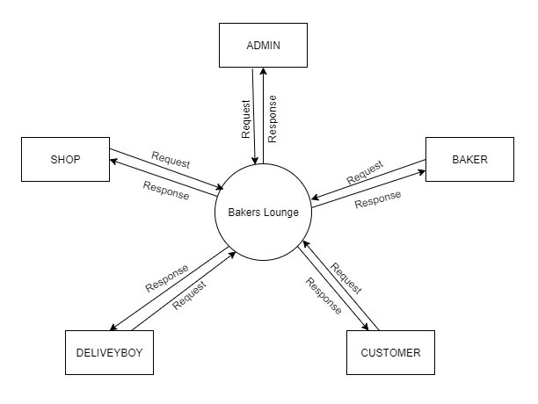
LEVEL 0 DFD

Slide 29
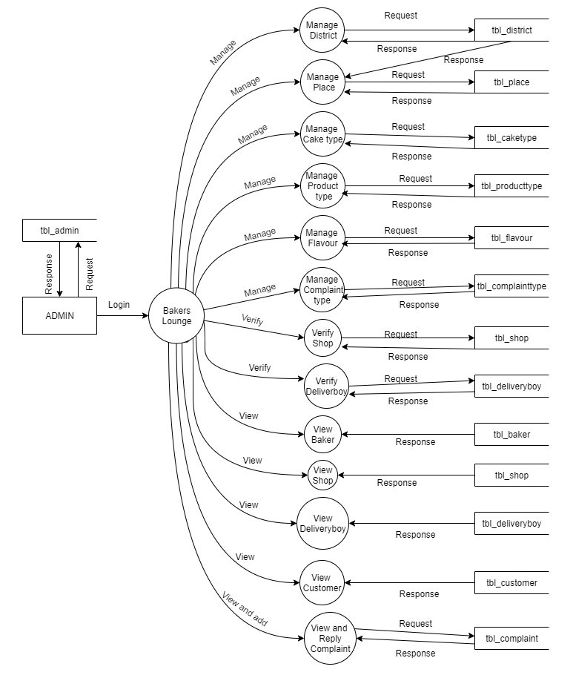
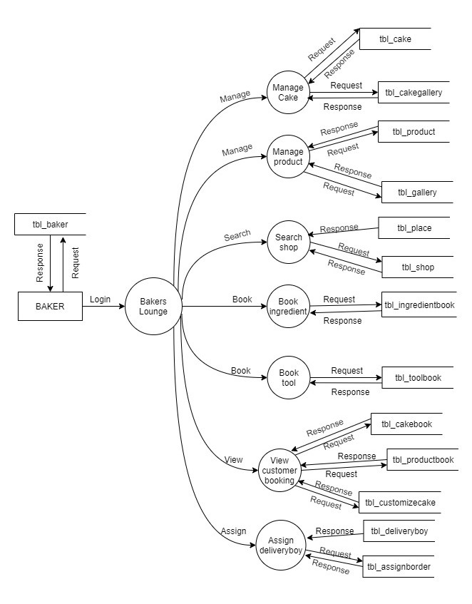
LEVEL 1 DFD ADMIN
LEVEL 1 DFD BAKER

Slide 30
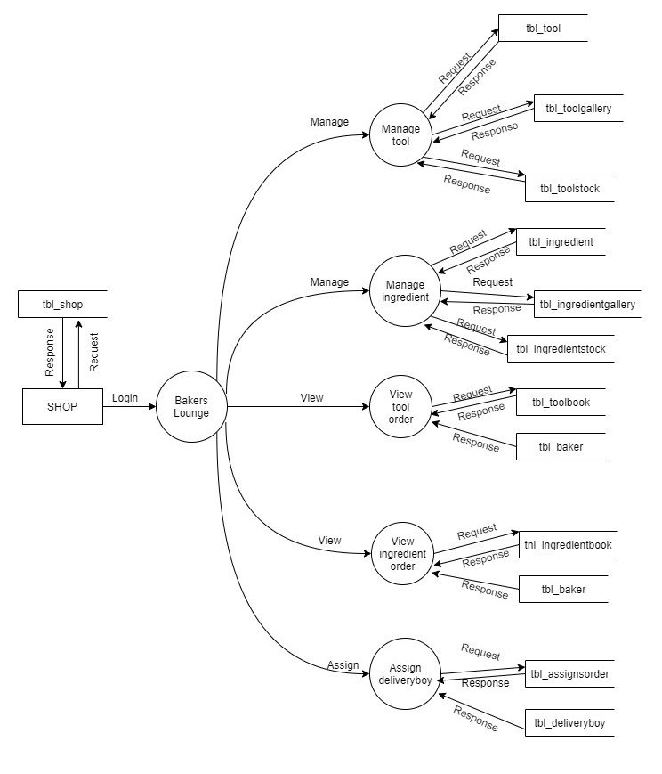
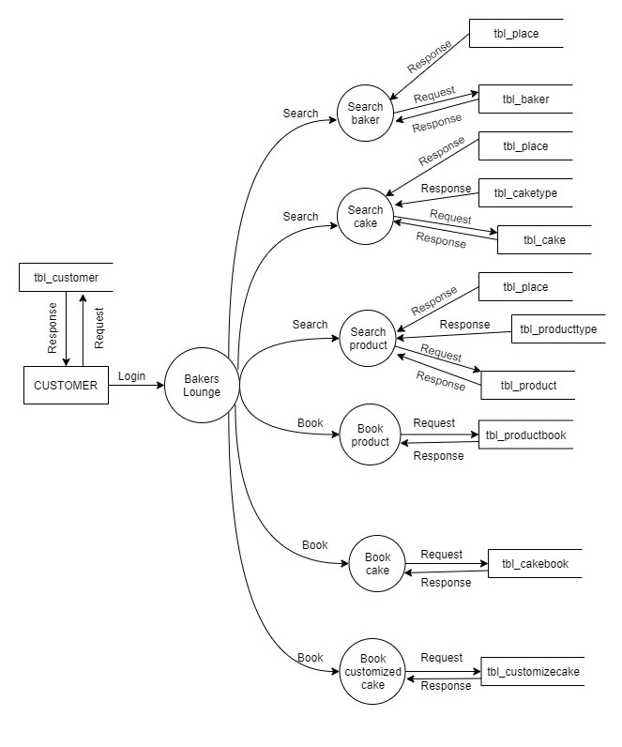
LEVEL 1 DFD SHOP
LEVEL 1 DFD CUSTOMER

Slide 31
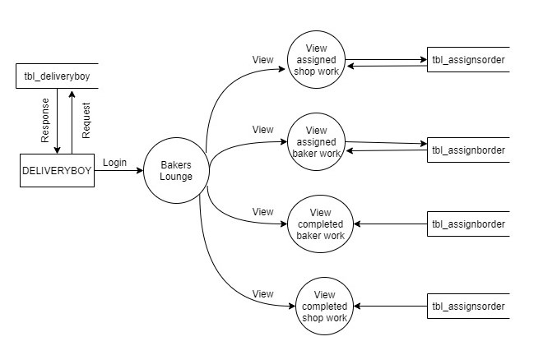
LEVEL 1 DFD DELIVERY BOY

Slide 32
Thank You

